Slide 1
Low Level I/O in LINUX

Slide 2
Low level I/O
Standard/Buffered I/O - C library
printf/scanf/gets/puts/getc/putc
fopen/fread/fwrite/fseek/fclose/fgets/fputc
FILE* , file pointer
Kernel – low level functions
open/read/write/close/lseek
File descriptor
(1024 per process , can be get/set through getrlimit/setrlimit)

Slide 3
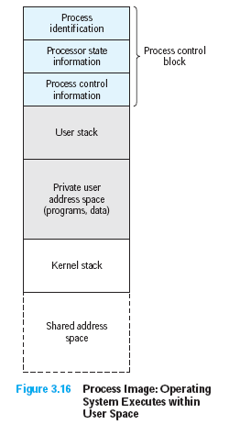
Kernel System Calls
Linux Process Model
Process Image

Slide 4
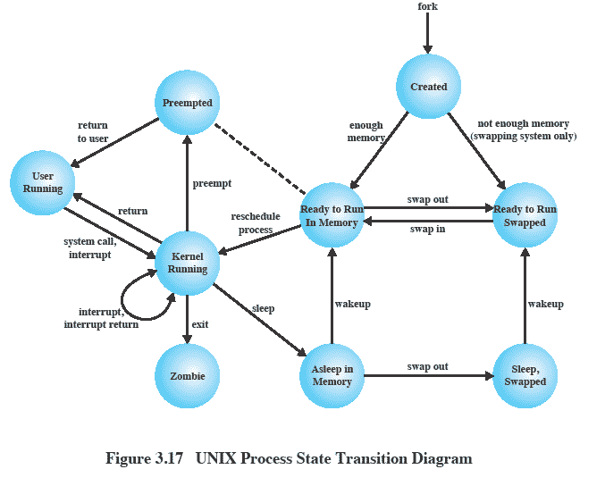
UNIX Process State Transition Diagram
Notes:
A total of nine process states are recognized by the UNIX SVR4 operating system;
This figure is similar to Figure 3.9b, with the two UNIX sleeping states corresponding to the two blocked states.
Point out that:
UNIX employs two Running states to indicate whether the process is executing in user mode or kernel mode.
Two states are essentially the same: (Ready to Run, in Memory) and (Pre-empted) as indicated by the dotted line. The distinction is made to emphasize the way in which the pre-empted state is entered. When a process is running in kernel mode (as a result of a supervisor call, clock interrupt, or I/O interrupt), there will come a time when the kernel has completed its work and is ready to return control to the user program. At this point, the kernel may decide to pre-empt the current process in favour of one that is ready and of higher priority. In that case, the current process moves to the pre-empted state. However, for purposes of dispatching, those processes in the pre-empted state and those in the Ready to Run, in Memory state form one queue.

Slide 5
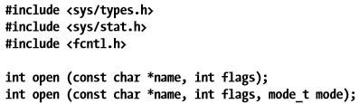
open()
int open(const char *pathname, int flags, mode_t mode);
Flags: O_RDONLY, O_WRONLY, or O_RDWR , O_APPEND,
O_ASYNC (Enable signal-driven I/O)
Mode: S_IRUSR | S_IWUSR | S_IRGRP | S_IWGRP | S_IROTH .. etc
R = read, W =write , X =execute
Owner of New File?
Permissions on new file?

Slide 6




Create()

Slide 7
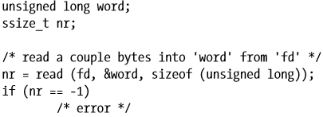
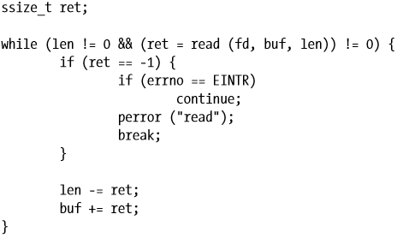
ssize_t read (int fd, void *buf, size_t len);

Slide 8
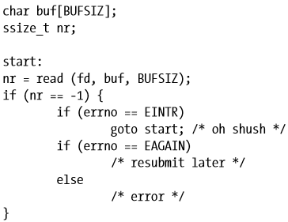
Non Blocking Read
If file was opened with O_NONBLOCK then check EAGAIN
Other Errors?
Read size Limits?

Slide 9
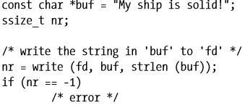
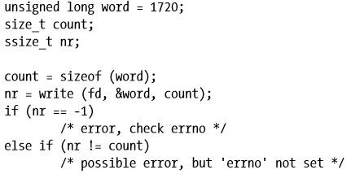
ssize_t write (int fd, const void *buf, size_t count);

Slide 10
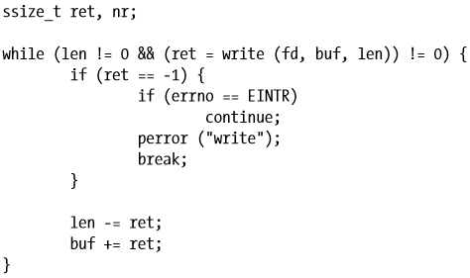
Partial writes

Slide 11
0_file_timestamp.c
char* get_timestamp ()
{
time_t now = time (NULL);
return asctime (localtime (&now));
}
int main (int argc, char* argv[])
{
char* filename = argv[1];
char* timestamp = get_timestamp ();
int fd = open (filename, O_WRONLY | O_CREAT | O_APPEND, 0666);
size_t length = strlen (timestamp);
write (fd, timestamp, length);
close (fd);
return 0;
}
% ./0_file_timestamp tsfile
% cat tsfile
Thu Feb 1 23:25:20 2001
% ./ 0_file_timestamp tsfile
% cat tsfile
Thu Feb 1 23:25:20 2001
Thu Feb 1 23:25:47 2001

Slide 12
write
Append Mode?
Other possible errors?
Size limit?
Kernel writing process?
hint : Transferring file to USB
What is Direct I/O ?

Slide 13
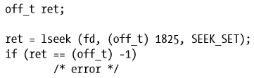

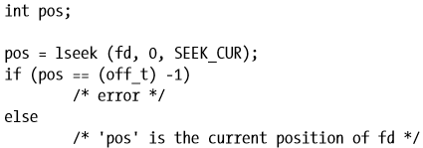
Seek
off_t lseek (int fd, off_t pos, int origin);
SEEK_SET The offset is set to offset bytes.
SEEK_CUR The offset is set to its current location plus offset bytes.
SEEK_END The offset is set to the size of the file plus offset bytes.

Slide 14
Creating large file with lseek
int main (int argc, char* argv[])
{
int zero = 0;
const int megabyte = 1024 * 1024;
char* filename = argv[1];
size_t length = (size_t) atoi (argv[2]) * megabyte;
int fd = open (filename, O_WRONLY | O_CREAT | O_EXCL, 0666);
/* Jump to 1 byte short of where we want the file to end. */
lseek (fd, length - 1, SEEK_SET);
write (fd, &zero, 1);
close (fd);
return 0;
}
% ./lseek-huge bigfile 15
% ls -l bigfile
-rw-r----- 1 samuel samuel ….

Slide 15
Positional Read/Write
ssize_t pread (int fd, void *buf, size_t count, off_t pos);
ssize_t pwrite (int fd, const void *buf, size_t count, off_t pos);

Slide 16
Reading Assignment
How linux/unix kernel implements I/O?
VFS
Page Cache
Page Writeback

Slide 17
Buffered/Standard I/O
Why kernel buffer I/O in kernel space?
Why buffering at user space?
Block size?
512,1024,2k,4k
_IONBF (Unbuffered) , _IOLBF (Line-buffered) , _IOFBF (Block-buffered)
int setvbuf (FILE *stream, char *buf, int mode, size_t size);

Slide 18
Standard C I/O Functions
#include <stdio.h>
File Pointer (FILE *fp)
FILE * fopen (const char *path, const char *mode);
r, r+, w, w+, a, a+ , append ‘b’ for binary files
FILE * fdopen (int fd, const char *mode);
int fclose (FILE *stream);
int fcloseall (void);

Slide 19
Standard C I/O Functions
int fgetc (FILE *stream);
int ungetc (int c, FILE *stream);
int fputc (int c, FILE *stream);
char * fgets (char *str, int size, FILE *stream);
int fputs (const char *str, FILE *stream);
size_t fread (void *buf, size_t size, size_t nr, FILE *stream);
size_t fwrite (void *buf, size_t size, size_t nr, FILE *stream);
int fflush (FILE *stream); // fsync( ) →kernel to file

Slide 20
Standard C I/O Functions
int fseek (FILE *stream, long offset, int whence);
void rewind (FILE *stream);
int fsetpos (FILE *stream, fpos_t *pos);
long ftell (FILE *stream);
int fgetpos (FILE *stream, fpos_t *pos);

Slide 21
Assignment
Write a program to copy file at backup folder.
Image jpeg/png
Compressed zip/rar
Word file

Slide 22
Concurrent I/O Calls
Thread safety
Manual file locking and unlocking
void flockfile (FILE *stream);
void funlockfile (FILE *stream);
int ftrylockfile (FILE *stream);
How to test?
Assignments after multithreading topic

Slide 23
Unlocked Stream Operations
#define _GNU_SOURCE
#include <stdio.h>
int fgetc_unlocked (FILE *stream);
char *fgets_unlocked (char *str, int size, FILE *stream);
size_t fread_unlocked (void *buf, size_t size, size_t nr, FILE *stream);
int fputc_unlocked (int c, FILE *stream);
int fputs_unlocked (const char *str, FILE *stream);
size_t fwrite_unlocked (void *buf, size_t size, size_t nr,FILE *stream);
int fflush_unlocked (FILE *stream);
int feof_unlocked (FILE *stream);
int ferror_unlocked (FILE *stream);
int fileno_unlocked (FILE *stream);
void clearerr_unlocked (FILE *stream);

Slide 24
Files and Their Metadata
#include <sys/types.h>
#include <sys/stat.h>
#include <unistd.h>
int stat (const char *path, struct stat *buf);
int fstat (int fd, struct stat *buf);
int lstat (const char *path, struct stat *buf);

Slide 25
struct stat
struct stat {
dev_t st_dev; /* ID of device containing file */
ino_t st_ino; /* inode number */
mode_t st_mode; /* permissions */
nlink_t st_nlink; /* number of hard links */
uid_t st_uid; /* user ID of owner */
gid_t st_gid; /* group ID of owner */
dev_t st_rdev; /* device ID (if special file) */
off_t st_size; /* total size in bytes */
blksize_t st_blksize; /* blocksize for filesystem I/O */
blkcnt_t st_blocks; /* number of blocks allocated */
time_t st_atime; /* last access time */
time_t st_mtime; /* last modification time */
time_t st_ctime; /* last status change time */
};

